Slide 1
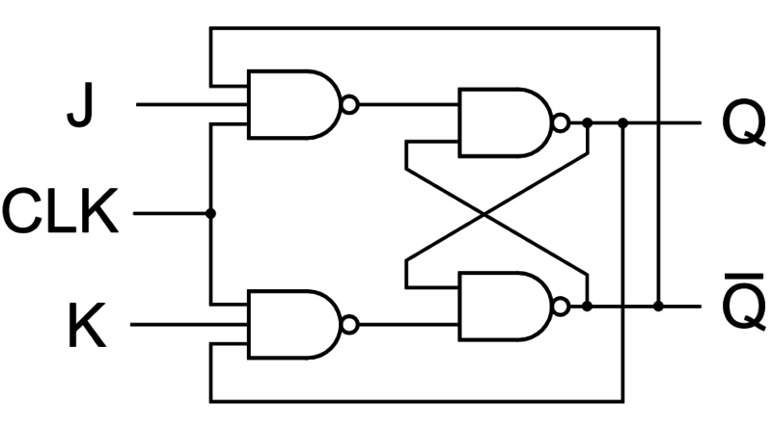
JK Flip Flop

Slide 2
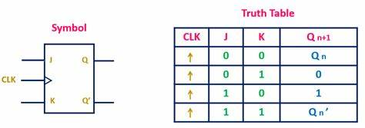
Truth table of JK Flip Flop

Slide 3
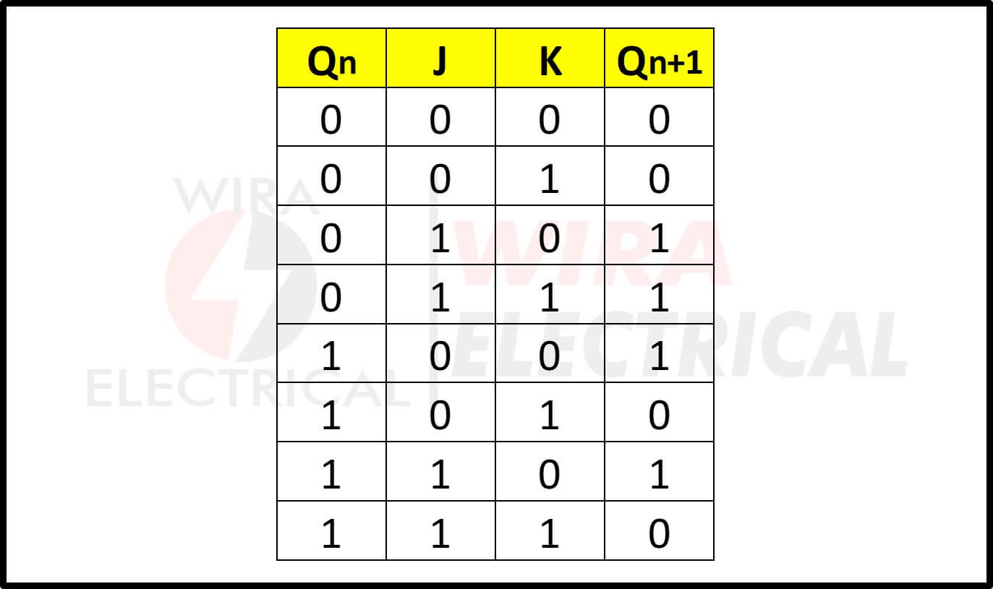
Characteristic Table of JK Flip Flop

Slide 4
Excitation table of JK Flip Flop
INPUTS |  | OUTPUTS
Q_{n} | Q_{n+1} | J | K
0 | 0 | 0 | X
0 | 1 | 1 | X
1 | 0 | X | 1
1 | 1 | X | 0

Slide 5
Race around
Race Around Condition in JK Flip-Flop
occurs when, J=K=1
The ON time of the clock is more than the propagation delay of the JK Flip-Flop
Due to feedback from output to input, the output of the flip-flop toggles continuously between ‘1’ and ‘0’.
This makes the output unstable or uncertain.

Slide 6
Master-Slave JK Flip Flop
The Master-Slave Flip-Flop is basically a combination of two JK flip-flops connected together in a series configuration. Out of these, one acts as the “master” and the other as a “slave”. The output from the master flip flop is connected to the two inputs of the slave flip flop whose output is fed back to inputs of the master flip flop. In addition to these two flip-flops, the circuit also includes an inverter.

Slide 7
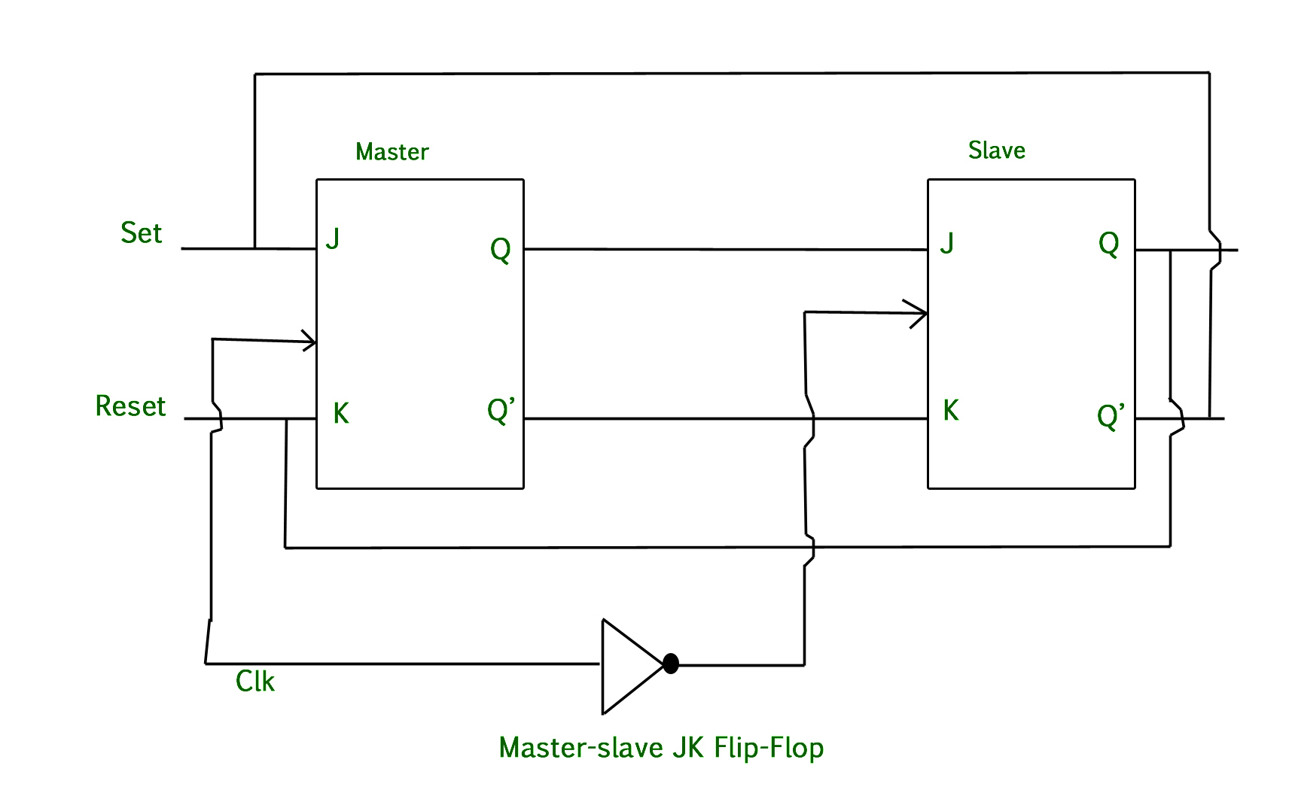
Master-Slave JK Flip Flop

Slide 8
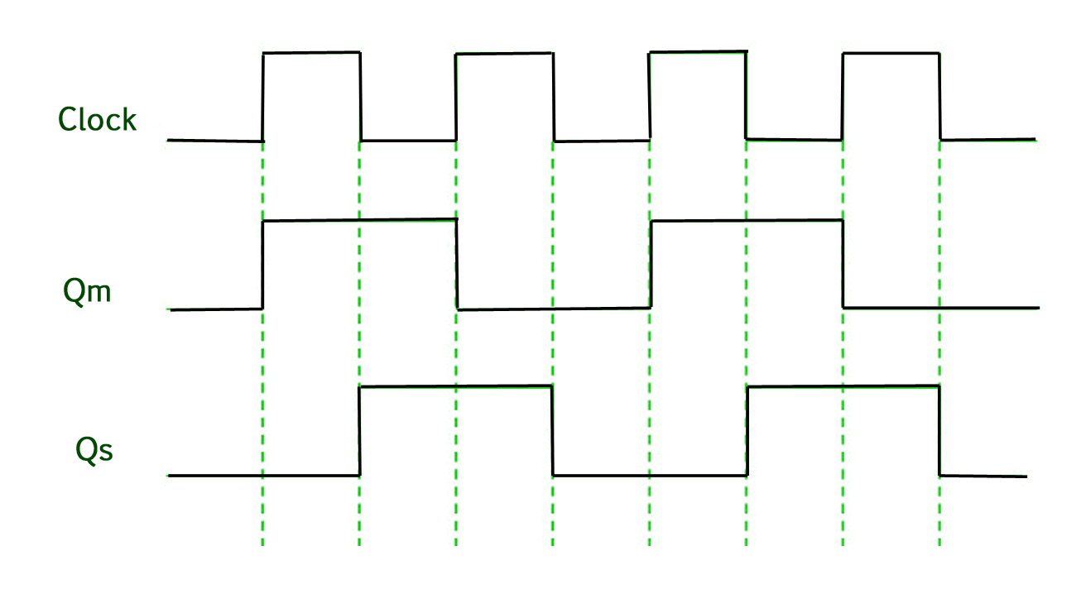
Timing diagram of MS-JK Flip Flop

Slide 9
Timing diagram of MS-JK Flip Flop

Slide 10
Timing diagram of MS-JK Flip Flop

Slide 11
Timing diagram of MS-JK Flip Flop

Slide 12
Timing diagram of MS-JK Flip Flop

